Slide 1

Alvin Ashcraft | alvinashcraft.com
Sr. Content Developer
Microsoft

Slide 2
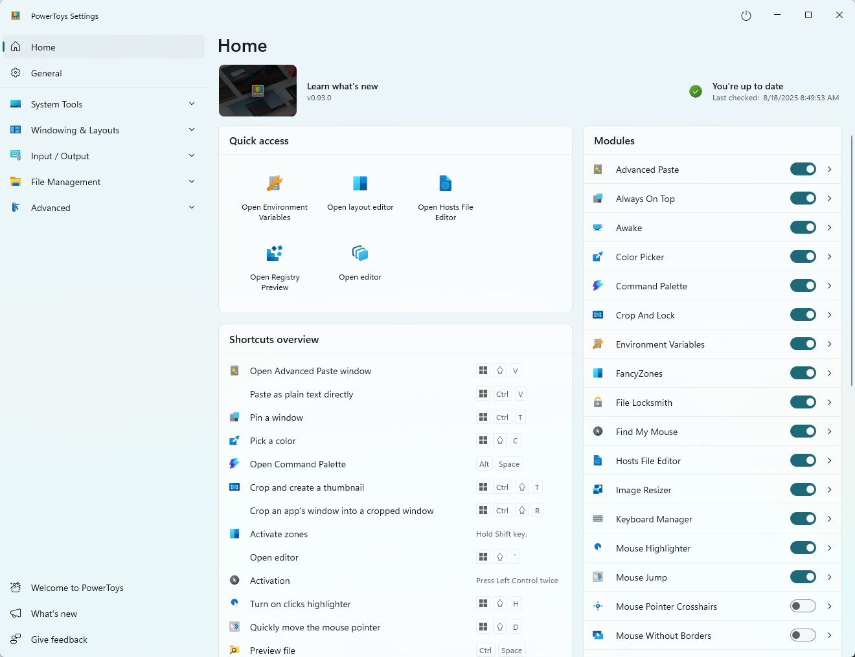
Free and Open-Source
First Windows 95 release in 1996
Re-launched for Windows 10 in 2019
25+ utilities for Windows 10 & 11
Install from MS Store, WinGet or GitHub
Contribute at github.com/microsoft/powertoys
Docs at learn.microsoft.com/windows/powertoys
Next release coming later in January

Slide 3
Command Palette
Quick launcher utility
Default shortcut: Win+Alt+Space
Launch commands, apps & dev tools
Like Spotlight for macOS
Extensions available or build one!

Slide 4
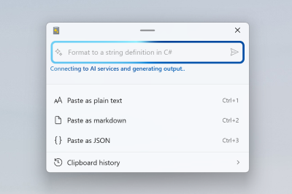
Advanced Paste
Paste plain text, markdown & JSON
Paste image as text or .png
Paste with AI (local/cloud models)
Transcode audio/video (paste as .mp3/.mp4)
Clipboard history

Slide 5
Awake!
Keep your PC awake for long running tasks
Interval
Until date/time
Infinite
Option to keep screen on
CLI available

Slide 6
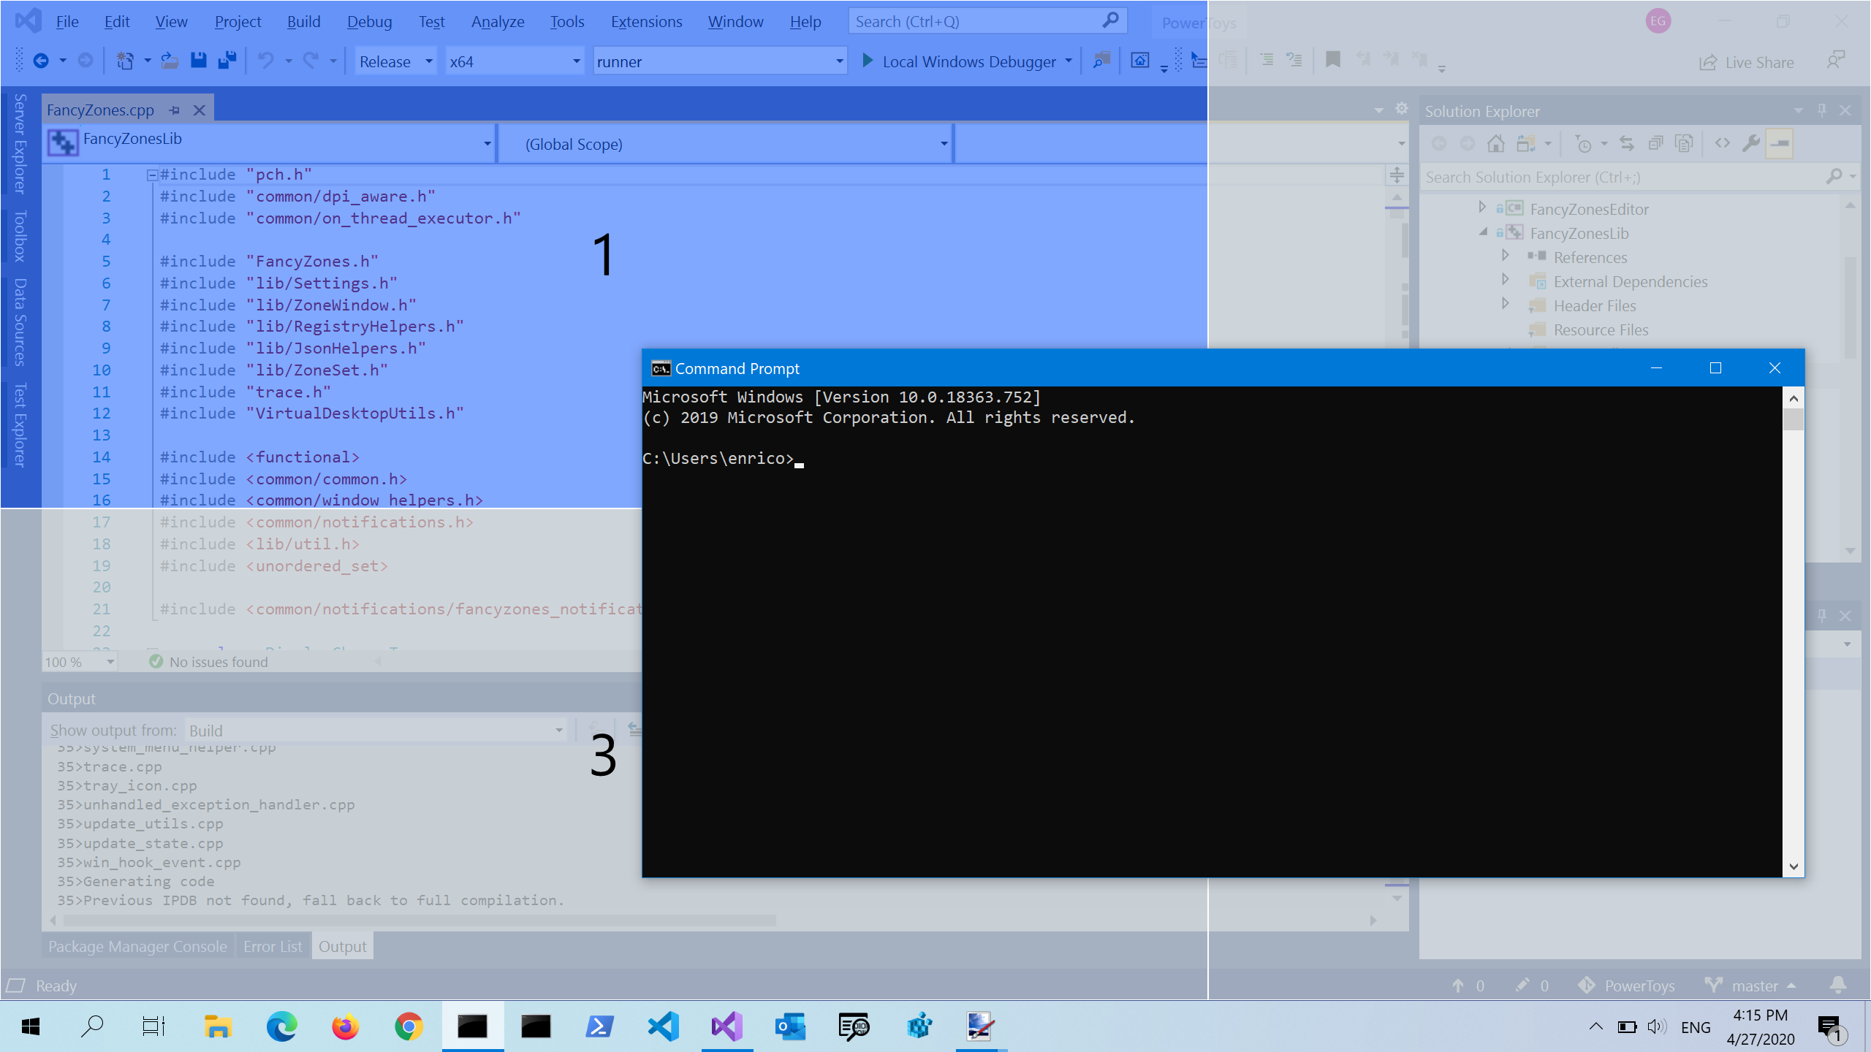
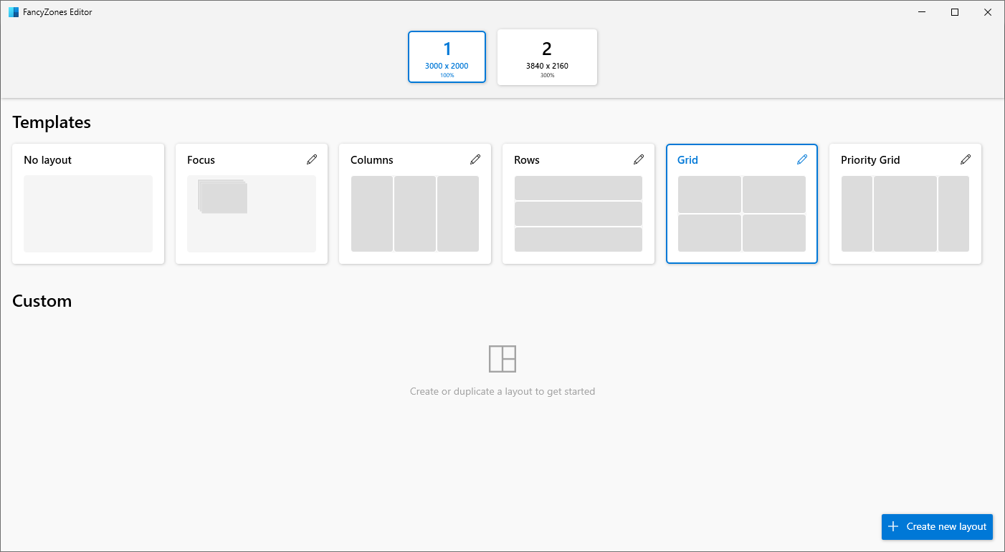
FancyZones
Window manager
Multi-monitor support
Templates or custom layouts
Quickly switch between layouts
Snap with mouse or keyboard

Slide 7
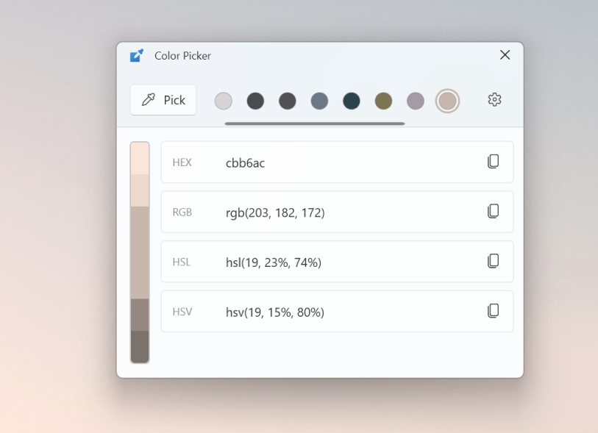
Color Picker
Pick colors from your screen
Formats: HEX / RGB / HSL / HSV
Always on top option
Fine tune after picking

Slide 8
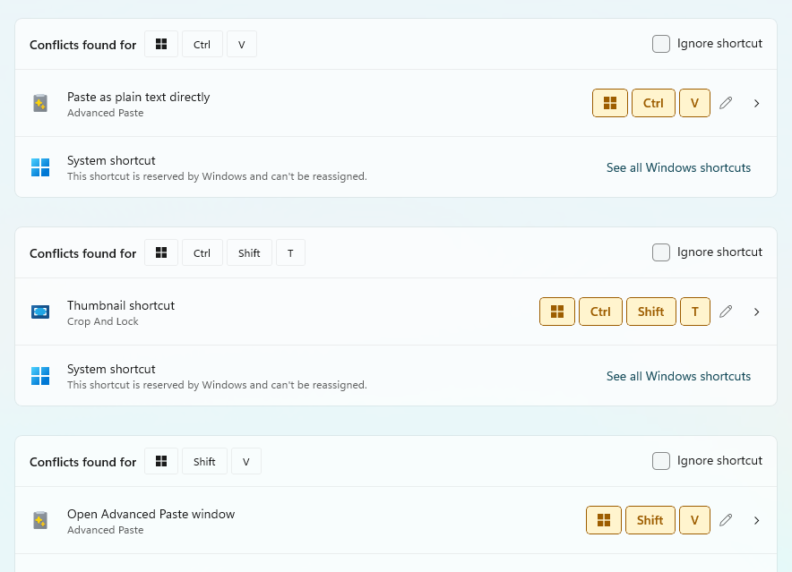
More favs
← Detect shortcut conflicts
Always on Top – Control any window
File Locksmith – Find out who’s locking a file
Light Switch – Light/Dark theme switcher
Workspaces – Launch and auto-arrange your apps
ZoomIt – Sysinternals tool now in PowerToys
Image Resizer – Quickly resize images from context menu

